Slide 1
BIDW – O2 – H
Data Mapping Document
Dataset: 2015 – 2017 H_2A Visa Applications
Content:
Database Schema
Dimension Design Tables
ETL Maps

Slide 2
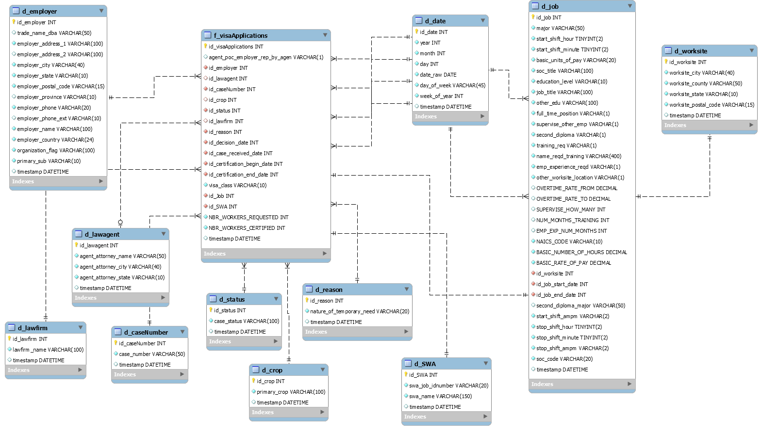
Database Schema:

Slide 3
Database Tables:
Fact Table
f_visaApplication

Slide 4
Database Tables:
Dimension Table
d_job

Slide 5
Database Tables:
Dimension Table
d_worksite

Slide 6
Database Tables:
Dimension Table
d_Date

Slide 7
Database Tables:
Dimension Table
d_SWA

Slide 8
Database Tables:
Dimension Table
d_reason

Slide 9
Database Tables:
Dimension Table
d_crop

Slide 10
Database Tables:
Dimension Table
d_status

Slide 11
Database Tables:
Dimension Table
d_employer

Slide 12
Database Tables:
Dimension Table
d_lawagent

Slide 13
Database Tables:
Dimension Table
d_casenumber

Slide 14
Database Tables:
Dimension Table
d_lawfirm

Slide 15
ETL MAPPINGS:
ETL Map Data Prep:
Replace in String:
Columns: case_received_date, certification_begin_date, certification_end_date, decision_date, job_start_date, job_end_date.
RegEx Pattern: (T.*)
Replacement:
Extract from CSV file:
File Name: H_2AVisaApplications_stacked_prepared.csv
String Operations:
Every Column: Remove Special Characters (CR & LF)
Split Field:
Field: start_min_X, end_min_X
Delimiter: ‘ ‘
Result fields: start_minutes, start_AMPM, end_minutes, end_AMPM
Split Field:
Field: hourly_work_schedule_am, hourly_work_schedule_pm
Delimiter: ‘ : ‘
Result fields: start_hour, start_min_X, end_hour, end_min_X
Select Values:
Columns: case_received_date, certification_begin_date, certification_end_date, decision_date, job_start_date, job_end_date.
Metadata: change to Date
Format: yyyy-MM-dd
Text File Output:
Columns: ALL
File type: CSV
Delimiter: ‘ , ‘
File Name: h_2datasetclean.csv

Slide 16
ETL MAPPINGS:
ETL Map d_employer:
Select Values:
Columns: trade_name_dba, employer_address1, employer_address2, employer_state, employer_city, employer_postal_code, employer_province, employer_phone, employer_phone_ext, employer_name, employer_country, organization_flag, primary_sub
Sort Rows:
Columns: trade_name_dba, employer_address1, employer_address2, employer_state, employer_city, employer_postal_code, employer_province, employer_phone, employer_phone_ext, employer_name, employer_country, organization_flag, primary_sub
Extract from CSV file:
File Name: H_2AVisaApplications_stacked_prepared.csv
If Value Null:
Columns: trade_name_dba, employer_address1, employer_address2, employer_state, employer_city, employer_postal_code, employer_province, employer_phone, employer_phone_ext, employer_name, employer_country, organization_flag, primary_sub
Replace: ‘unknown’
Unique Rows:
Columns: trade_name_dba, employer_address1, employer_address2, employer_state, employer_city, employer_postal_code, employer_province, employer_phone, employer_phone_ext, employer_name, employer_country, organization_flag, primary_sub
Insert / Update:
Schema: h_2aapplicationdb
Table: d_employer
Get System Info:
Field: timestamp
Type: system date (fixed)

Slide 17
ETL MAPPINGS:
ETL Map d_lawagent:
Extract from CSV file:
File Name: H_2AVisaApplications_stacked_prepared.csv
Select Values:
Columns: agent_attorney_name, agent_attorney_city, agent_attorney_state
Sort Rows:
Columns: agent_attorney_name, agent_attorney_city, agent_attorney_state
If Value Null:
Columns: agent_attorney_name, agent_attorney_city, agent_attorney_state
Replace: ‘unknown’
Unique Rows:
Columns: agent_attorney_name, agent_attorney_city, agent_attorney_state
Insert / Update:
Schema: h_2aapplicationdb
Table: d_lawagent
Get System Info:
Field: timestamp
Type: system date (fixed)

Slide 18
ETL MAPPINGS:
ETL Map d_lawfirm:
Extract from CSV file:
File Name: H_2AVisaApplications_stacked_prepared.csv
Select Values:
Columns: lawfirm_name
Sort Rows:
Columns: lawfirm_name
Insert / Update:
Schema: h_2aapplicationdb
Table: d_lawfirm
Get System Info:
Field: timestamp
Type: system date (fixed)
If Value Null:
Columns: lawfirm_name Replace: ‘unknown’
Unique Rows:
Columns: lawfirm_name

Slide 19
ETL MAPPINGS:
ETL Map d_casenumber:
Extract from CSV file:
File Name: H_2AVisaApplications_stacked_prepared.csv
Select Values:
Columns: case_number
Sort Rows:
Columns: case_number
Insert / Update:
Schema: h_2aapplicationdb
Table: d_casenumber
Get System Info:
Field: timestamp
Type: system date (fixed)
If Value Null:
Columns: case_number
Replace: ‘unknown’
Unique Rows:
Columns: case_number

Slide 20
ETL MAPPINGS:
ETL Map d_status:
Extract from CSV file:
File Name: H_2AVisaApplications_stacked_prepared.csv
Select Values:
Columns: case_status
Sort Rows:
Columns: case_status
Insert / Update:
Schema: h_2aapplicationdb
Table: d_status
Get System Info:
Field: timestamp
Type: system date (fixed)
If Value Null:
Columns: case_status
Replace: ‘unknown’
Unique Rows:
Columns: case_status

Slide 21
ETL MAPPINGS:
ETL Map d_crop:
Extract from CSV file:
File Name: H_2AVisaApplications_stacked_prepared.csv
Select Values:
Columns: primary_crop
Sort Rows:
Columns: primary_crop
Insert / Update:
Schema: h_2aapplicationdb
Table: d_crop
Get System Info:
Field: timestamp
Type: system date (fixed)
If Value Null:
Columns: primary_crop
Replace: ‘unknown’
Unique Rows:
Columns: primary_crop

Slide 22
ETL MAPPINGS:
ETL Map d_reason:
Extract from CSV file:
File Name: H_2AVisaApplications_stacked_prepared.csv
Sort Rows:
Columns: nature_of_temporary_need
Select Values:
Columns: nature_of_temporary_need
Insert / Update:
Schema: h_2aapplicationdb
Table: d_reason
Get System Info:
Field: timestamp
Type: system date (fixed)
If Value Null:
Columns: nature_of_temporary_need
Replace: ‘unknown’
Unique Rows:
Columns: nature_of_temporary_need

Slide 23
ETL MAPPINGS:
ETL Map d_swa:
Extract from CSV file:
File Name: H_2AVisaApplications_stacked_prepared.csv
Sort Rows:
Columns: swa_name, job_idnumber
Select Values:
Columns: swa_name, job_idnumber
Insert / Update:
Schema: h_2aapplicationdb
Table: d_swa
Get System Info:
Field: timestamp
Type: system date (fixed)
If Value Null:
Columns: swa_name, job_idnumber
Replace: ‘unknown’
Unique Rows:
Columns: swa_name, job_idnumber

Slide 24
ETL MAPPINGS:
ETL Map d_worksite:
Extract from CSV file:
File Name: H_2AVisaApplications_stacked_prepared.csv
Select Values:
Columns: worksite_city, worksite_county, worksite_postal_code, worksite_state
Sort Rows:
Columns: worksite_city, worksite_county, worksite_postal_code, worksite_state
If Value Null:
Columns: worksite_city, worksite_county, worksite_postal_code, worksite_state
Replace: ‘unknown’
Unique Rows:
Columns: worksite_city, worksite_county, worksite_postal_code, worksite_state
Insert / Update:
Schema: h_2aapplicationdb
Table: d_worksite
Get System Info:
Field: timestamp
Type: system date (fixed)

Slide 25
ETL MAPPINGS:
Create 1 Select Per Date to parallelize the sort/unique steps
ETL Map d_date:
Select Values:
Columns: case_received_date, decision_date, certification_begin_date, certification_end_date, job_start_date, job_end_date
Rename: ALL to “date_raw”
Sort Rows:
Column1: date_raw
Column2: date_raw
Column3: date_raw
Column4: date_raw
Column5: date_raw
Column6: date_raw
Extract from CSV file:
File Name: H_2AVisaApplications_stacked_prepared.csv
Unique Rows:
Column: date_raw
Sort Rows:
Column: date_raw
Unique Rows:
Column1: date_raw
Column2: date_raw
Column3: date_raw
Column4: date_raw
Column5: date_raw
Column6: date_raw
Append Streams:
Append all 6 Streams into a single ‘date_raw’ stream
Calculator:
Column1: year
Operation1: Year of Date
Column2: month
Operation2: Month of Date
Column3: day
Operation3: Day of month of Date
Column4: day_of week
Operation4: Day of Week of Date
Column5: week_of_year
Operation5: Week of Year of Date
Value Mapper:
Column: day_of_week
Map:
1 = Sun
2 = Mon
3 = Tue
4 = Wed
5 = Thu
6 = Fri
7 =Sat
Get System Info:
Field: timestamp
Type: system date (fixed)
Insert / Update:
Schema: h_2aapplicationdb
Table: d_date

Slide 26
ETL MAPPINGS:
Select Values:
Columns: basic_number_of_hours, basic_rate_of_pay, basic_unit_of_pay, education_level, emp_exp_num_months, emp_experience_reqd, end_AMPM, end_hour, end_minutes, full_time_position, job_title, major, naics_code, name_reqd_training, num_months_training, other_edu, other_worksite_location, overtime_rate_from, overtime_rate_to, second_diploma, second_diploma_major, soc_code, soc_title, start_AMPM, start_hour, start_minutes, supervise_how_many, supervise_other_emp, training_req, job_start_date, job_end_date, worksite_city, worksite_county, worksite_state, worsksite_postal_code
Database Lookup:
Schema: h_2aaplicationdb
Table: d_date
Lookupvalue: job_start_date
Get: id_date
Delete: Lookup fields
ETL Map d_job:
Extract from CSV file:
File Name: H_2AVisaApplications_stacked_prepared.csv
Select Value:
Column: ALL
Rename: id_date = id_job_start_date
Sort Rows:
Columns: ALL
Database Lookup:
Schema: h_2aaplicationdb
Table: d_worksite
Lookupvalue: worksite_city, worksite_county, worksite_state, worksite_postal_code
Get: id_worksite
Delete: Lookup fields
Select Value:
Column: ALL
Rename: id_date = id_job_end_date
Database Lookup:
Schema: h_2aaplicationdb
Table: d_date
Lookupvalue: job_end_date
Get: id_date
Delete: Lookup fields
Unique Rows:
Columns: ALL
Insert / Update:
Schema: h_2aapplicationdb
Table: d_worksite
Get System Info:
Field: timestamp
Type: system date (fixed)

Slide 27
ETL MAPPINGS:
Select Values:
Columns: ALL
Database Lookup:
Schema: h_2aaplicationdb
Table: d_date
Lookupvalue: decision_date
Get: id_date
Delete: Lookup fields
Select Value:
Column: ALL
Rename: id_date = id_decision_date
ETL Map f_visaApplications:
Extract from CSV file:
File Name: H_2AVisaApplications_stacked_prepared.csv
Database Lookup:
Schema: h_2aaplicationdb
Table: d_date
Lookupvalue: case_received_date
Get: id_date
Delete: Lookup fields
Database Lookup:
Schema: h_2aaplicationdb
Table: d_date
Lookupvalue: certification_begin_date
Get: id_date
Delete: Lookup fields
Select Value:
Column: ALL
Rename: id_date = id_case_received_date
Select Value:
Column: ALL
Rename: id_date = id_certification_begin_date
Database Lookup:
Schema: h_2aaplicationdb
Table: d_lawagent
Lookupvalue: attorney_name, agent_attorney_city, agent_attorney_state
Get: id_lawagent
Delete: Lookup fields
Database Lookup:
Schema: h_2aaplicationdb
Table: d_casenumber
Lookupvalue: case_number
Get: id_casenumber
Delete: Lookup fields
Database Lookup:
Schema: h_2aaplicationdb
Table: d_date
Lookupvalue: certification_end_date
Get: id_date
Delete: Lookup fields
Select Value:
Column: ALL
Rename: id_date = id_certification_end_date
Database Lookup:
Schema: h_2aaplicationdb
Table: d_swa
Lookupvalue: job_idnumber, swa_name
Get: id_swa
Delete: Lookup fields
Database Lookup:
Schema: h_2aaplicationdb
Table: d_lawfirm
Lookupvalue: lawfirm_name
Get: id_lawfirm
Delete: Lookup fields
Database Lookup:
Schema: h_2aaplicationdb
Table: d_crop
Lookupvalue: primary_crop
Get: id_crop
Delete: Lookup fields
Database Lookup:
Schema: h_2aaplicationdb
Table: d_status
Lookupvalue: case_status
Get: id_casestatus
Delete: Lookup fields
Database Lookup:
Schema: h_2aaplicationdb
Table: d_reason
Lookupvalue: nature_of_temporary_need
Get: id_reason
Delete: Lookup fields
Select Value:
Column: ALL
Rename: id_date = id_job_start_date
Database Lookup:
Schema: h_2aaplicationdb
Table: d_worksite
Lookupvalue: trade_name_dba, employer_address1, employer_address2, employer_state, employer_city, employer_postal_code, employer_province, employer_phone, employer_phone_ext, employer_name, employer_country, organization_flag, primary_sub Get: id_employer
Delete: Lookup fields
Database Lookup:
Schema: h_2aaplicationdb
Table: d_date
Lookupvalue: job_end_date
Get: id_date
Delete: Lookup fields
Database Lookup:
Schema: h_2aaplicationdb
Table: d_date
Lookupvalue: job_start_date
Get: id_date
Delete: Lookup fields
Select Value:
Column: ALL
Rename: id_date = id_job_end_date
Continued on next page/slide

Slide 28
ETL MAPPINGS:
Database Lookup:
Schema: h_2aaplicationdb
Table: d_job
Lookupvalue: basic_number_of_hours, basic_rate_of_pay, basic_unit_of_pay, education_level, emp_exp_num_months, emp_experience_reqd, end_AMPM, end_hour, end_minutes, full_time_position, job_title, major, naics_code, name_reqd_training, num_months_training, other_edu, other_worksite_location, overtime_rate_from, overtime_rate_to, second_diploma, second_diploma_major, soc_code, soc_title, start_AMPM, start_hour, start_minutes, supervise_how_many, supervise_other_emp, training_req, id_job_start_date, id_job_end_date, id_worksite
Get: id_job
Delete: Lookup fields
ETL Map f_visaApplications:
Database Lookup:
Schema: h_2aaplicationdb
Table: d_worksite
Lookupvalue: worksite_city, worksite_county, worksite_state, worksite_postal_code
Get: id_worksite
Delete: Lookup fields
CONT from last page
Select Value:
Column: agent_poc_employer_rep_by_agent, nbr_workers_certified, nbr_workers_requested, visa_class, id_decision_date, id_case_received_date, id_certification_begin_date, id_certification_end_date, id_lawagent, id_casenumber, id_crop, id_status, id_lawfirm, id_reason, id_SWA, id_employer, id_Job
Get System Info:
Field: timestamp
Type: system date (fixed)
Insert / Update:
Schema: h_2aapplicationdb
Table: f_visaApplications
Get System Info:
Field: timestamp
Type: system date (fixed)

